Slide 1

2018 REFRIGERATION TRAINING
PART 1

Slide 2
2018 REFRIGERATION TRAINING
Heat Energy
Heat Transfer
Pressure
Refrigerants
Refrigerant System-Basics
Temperature
Overview Refrigerators

Slide 3
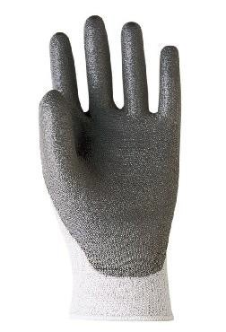
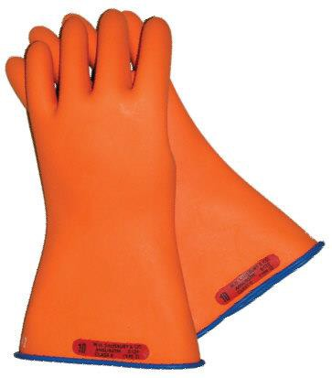







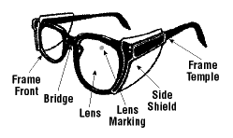
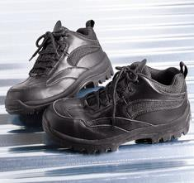
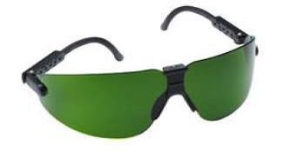









GE Factory Service Employees are required to use safety glasses with side shields, safety gloves & steel toe shoes for all repairs.
Electrically Rated Glove and Dyneema® Cut Resistant Glove Keeper
Plano Type Safety Glasses
Dyneema® Cut
Resistant Glove
Prescription Safety Glasses
Safety Glasses must be ANSI Z87.1-2003 compliant
Steel Toe Work Boot
Brazing Glasses

Slide 4
Prior to disassembly of the Refrigerator to access components, GE Factory Service technicians are REQUIRED to follow the Lockout / Tagout (LOTO) 6 Step Process
Step 1 Plan and Prepare | Step 4 Apply LOTO device & Lock
Step 2 Shut down the appliance | Step 5 Control (discharge) stored energy
Step 3 Isolate the appliance | Step 6 “Try It” Verify that the appliance is locked out

Slide 5
What is Refrigeration?
The process of moving heat from an area where it is not wanted, inside the refrigerator, to an area where it doesn’t matter, the area in which the refrigerator sits.

Slide 6
2018 REFRIGERATION TRAINING
Heat Energy

Slide 7
Heat energy
Heat exists in the air at all temperatures, below freezing as well as above all the way down to absolute zero (-460°F).
Heat flows from a higher temperature to a lower temperature regardless of how small that difference might be.
All gases become warmer when compressed.
Most matter exists in either a solid, liquid, or gaseous state.
example: Ice, Water or Steam
The temperature at which a material changes from a liquid to a gas (evaporates or boils) or from a gas to a liquid (condenses or liquefies) depends on the pressure at which it is contained.

Slide 8
Heat energy
Heat is a form of energy
Heat is never destroyed, it is simply transferred from one substance or place to another
Cold is a relative term and is really an absence of heat
Refrigeration is the process of removing heat.

Slide 9
Heat energy
Knowledge of some fundamental principles regarding heat is important:
Heat is a form of energy that can be measured by the effect it produces
It is provided by the sun and exists in every substance on the earth
The removal of heat from a substance lowers its temperature so by comparison one substance is colder than another
Most substances will expand when heated and contract when heat is removed
All substances are made up of tiny particles called molecules which are in a constant state of motion
As the temperature of any substance increases, the molecules move more rapidly to provide heat
As the temperature decreases, molecular activity slows down
At the temperature of absolute zero -460°F all molecular activity stops
A refrigerator or freezer produces a condition we refer to as cold by taking heat from inside the cabinet and transferring it to the outside

Slide 10
2018 REFRIGERATION TRAINING
Temperature – Transfer of Heat

Slide 11
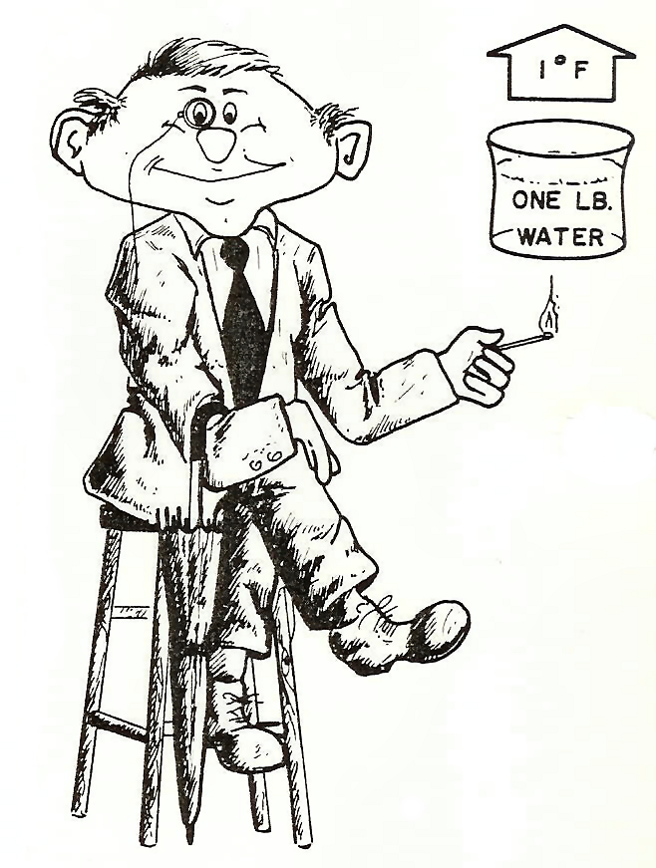
temperature
Temperature does not give us the amount of heat in an object - rather it is an indication of the warmth of the object
The British Thermal Unit (BTU) is the heat unit most commonly used in the United States for refrigeration purposes
One BTU is the amount of heat required to raise one pound of water one degree Fahrenheit
There is no direct measurement of heat, but we can measure its effects with a thermometer

Slide 12
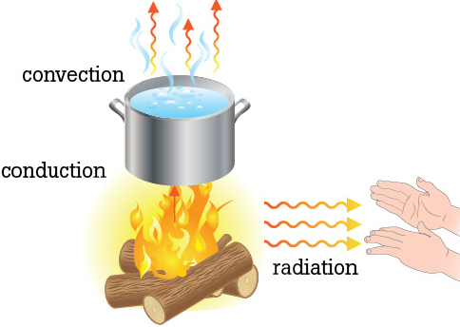
Transfer of heat
Heat flows from a higher temperature to a lower temperature regardless of how small the temperature difference might be
The rate of heat transfer is influenced by three factors: temperature difference, surface area, and material conductivity
The greater the temperature difference, or the larger the surface area of contact, or the better the conductivity of the material, the more quickly heat will flow
The transfer of heat may be by any of three methods or a combination of them
The heat transfer methods are:
conduction, convection and radiation

Slide 13
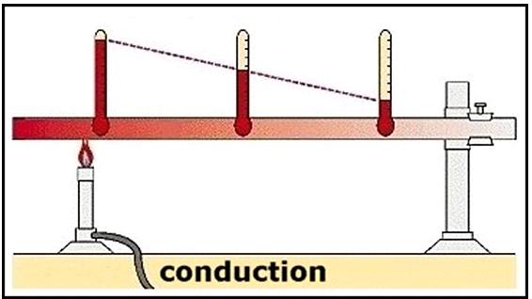
Transfer of heat conduction
One of the most important types of heat transfer in refrigeration is conduction.
Conduction is heat transfer by means of molecular agitation within a material without any motion of the material.
If one end of a metal rod is at a higher temperature, then energy will be transferred down the rod toward the colder end because the higher speed particles will collide with the slower ones with a net transfer of energy to the slower ones.

Slide 14
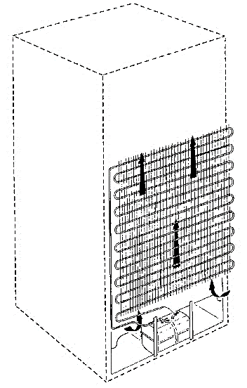
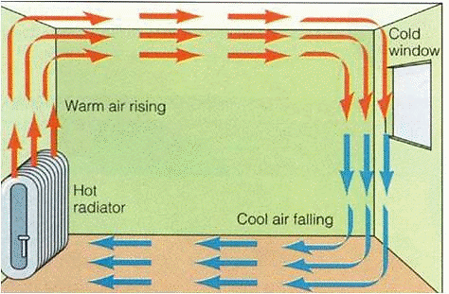
Transfer of heat convection
Convection is the conveying of heat from one place to another by the movement of some easily circulated medium, such as water or air.
Convection occurs because hot air expands, becomes less dense, and rises. Hot water is likewise less dense than cold water and rises, causing convection currents which transport energy.

Slide 15
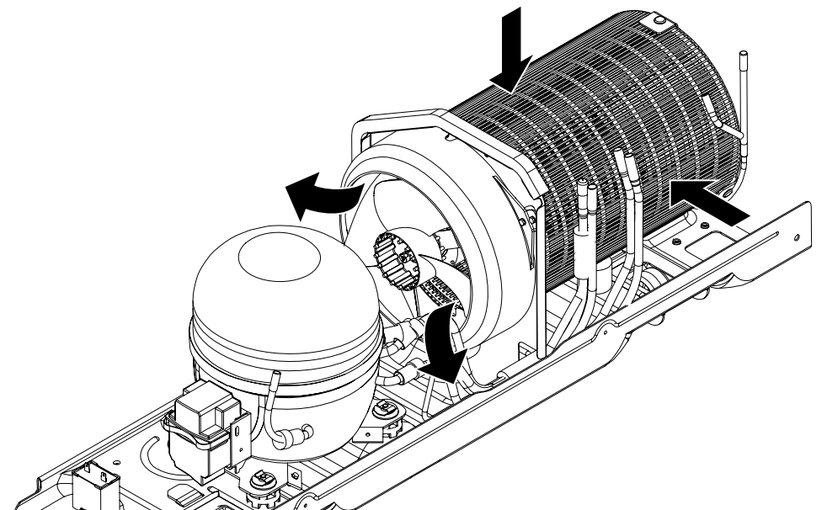
Transfer of heat forced convection
In refrigerators, we use a fan and circulate air as the transfer medium.
This form of heat transfer is not considered a separate type but rather a modification of the convection called Forced Convection.

Slide 16
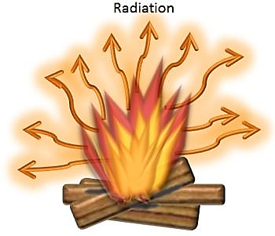
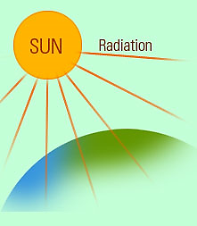
Transfer of heat radiation
Radiation is heat transferred from one object to another without changing the temperature of the medium between the two objects.

Slide 17
2018 REFRIGERATION TRAINING
Matter – Change of State

Slide 18
Forms of matter
Matter exists as either a solid, liquid or gas depending on their temperature, pressure and heat content.
For example, water is a solid below 32°F, a liquid from 32°F to 212°F, and a vapor above 212°F at sea level and at atmospheric pressure

Slide 19
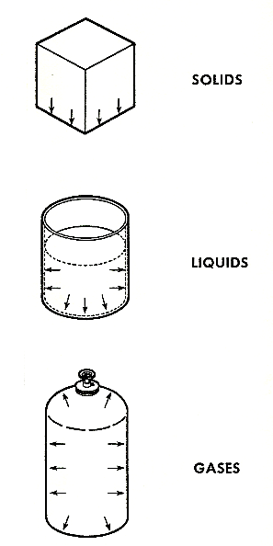
Forms of matter
A solid is any physical substance which retains its shape even though it is unsupported. It’s made up of billions of molecules, all exactly the same size, weight, and shape. They stay in the same location and constantly vibrate back and forth. The rate of vibration depends on the temperature. The lower the temperature, the slower the molecules vibrate. The higher the temperature, the faster they vibrate. These molecules are strongly attracted to each other and considerable force is necessary to move them.
A liquid is any substance that will assume the shape of its container (sides and bottom) and its molecules are also strongly attracted to each other. These molecules can be pictured as swimming among each other but never leaving. As the temperature rises, the molecules swim faster and the warmer molecules move upward toward the top of the container.
A gas is any substance which must be contained in a sealed container or it will soon dissipate. The molecules have little or no attraction for each other or any other substance and will uniformly fill any container in which they are placed.

Slide 20
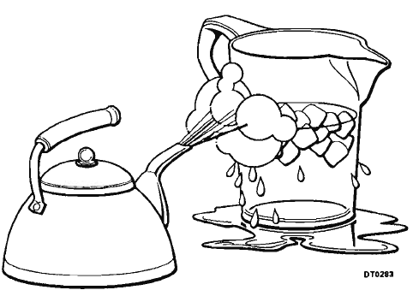
Change of state
The 4 Changes of State:
Melting - changing from a solid to a liquid
Fusion - changing from a liquid to a solid
Vaporizing (or evaporation) - changing from a liquid to a vapor
Condensing (or condensation) - changing from a vapor to a liquid
Matter exists as either a solid, liquid or gas depending on their temperature, pressure and heat content.
Adding heat to a substance can change it from a solid to a liquid or from a liquid to a gas.
Removing heat from a substance can change it from a gas to a liquid or from a liquid to a solid
The operation of a refrigeration system is dependent upon the refrigerant changing state. The two changes of state of prime importance are evaporation (liquid to a vapor) and condensation (vapor to a liquid).

Slide 21
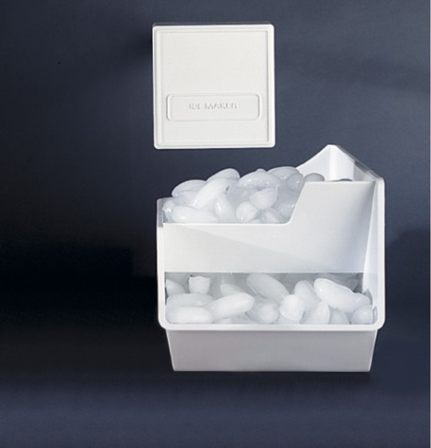

Change of state Sublimation
Sublimation is the transition of a substance directly from a solid to a gas without intermediately becoming a liquid.
Frost-free freezers circulate extremely dry sub-zero temperature air inside the freezer significantly accelerates the sublimation process.

Slide 22
2018 REFRIGERATION TRAINING
Temperature – Pressure Relationship

Slide 23
Temperature-pressure relationship
The temperature at which a material changes from a liquid to a gas or from a gas to a liquid is directly related to the pressure at which it is contained
Water boils at 212°F at atmospheric pressure. If the pressure is raised to 100 psig, the boiling point will be 338°F
However if we pull a 24“ Hg vacuum, the water will boil at 142°F and at 29.9" Hg vacuum water would boil at 35°F
This principle is why we pull a of vacuum on a refrigeration system
The pressure is lowered to a deep vacuum where any droplet of moisture in the system will boil into a vapor and then be drawn out of the system

Slide 24
Temperature-pressure relationship
The operation of a mechanical refrigerator or freezer is made possible by this pressure-temperature relationship.
The temperature at which r134a boils (evaporates) or condenses is the same if the pressure remains constant
r134a boils at 14.9°F at atmospheric pressure (0 psig).
If we reduce pressure to 12” Hg vacuum r134a will boil (evaporate) at -43.5°F .
If we raise the pressure to 100 psig r134a boils at 86.7°F

Slide 25
Temperature-pressure relationship
Increasing the pressure of a gas increases its temperature and heat content
The operation of refrigeration systems is dependent upon pressure differences
A low pressure is needed in the evaporator to enable the refrigerant to vaporize and absorb heat at a low temperature
A high pressure is needed in the condenser for the vapor to give up heat and condense back to a liquid
The compressor provides the pressure difference within the system

Slide 26
Temperature-pressure relationship
Effect of Pressure:
The temperature at which a substance will evaporate or condense is the same - if the pressure remains constant. For example: at sea level, water will change to steam when heated above 212°F and steam will change to water when cooled below 212°F. But, under a lower pressure (at a higher altitude) the change of state will occur at a lower temperature. Conversely, an increase in pressure will increase the temperature at which a substance will evaporate or condense.
Pressure is measured in pounds per square inch (PSI). It is stated either as absolute pressure (PSIA), or gauge pressure (PSIG). Normal atmospheric pressure at sea level is 14.7 pounds per square inch absolute (14.7 PSIA). In refrigeration systems, a compound gauge is used to measure pressures above and below atmospheric pressure. The gauge is calibrated so that a zero reading corresponds to the atmospheric pressure. Thus, a gauge reading above zero is a positive pressure and stated as pounds per square inch (PSIG). However, a gauge reading below zero is a vacuum and stated as inches of mercury (in.Hg).

Slide 27
2018 REFRIGERATION TRAINING
Heat of Compression

Slide 28
Heat of compression
Heat Of Compression necessary for the operation of the refrigeration system
Heat of compression occurs when:
the low pressure refrigerant vapor from the evaporator returns to the compressor at approximately room temperature
the compressor pumps the cool low pressure vapor into a hot high pressure vapor
the vapor is compressed, its temperature rises but little or no heat has been added
This is Heat of Compression
The temperature will rises due to the concentration of the heat in the vapor that is picked up in the evaporator then tightly packed into the cylinder of the compressor by the piston

Slide 29
Heat of compression
The vapor leaving the compressor is now hotter than the ambient air around the condenser
The heat that it picked up in the evaporator is given up to the air around the condenser
The hot refrigerant vapor condenses into a warm liquid

Slide 30
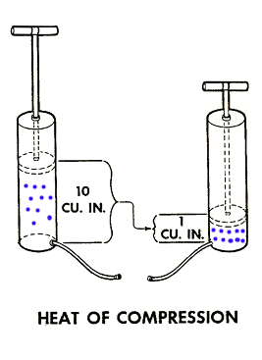
Heat of compression
A good example of "heat of compression" is an ordinary hand tire pump.
As the air is pumped into the tire, the lower part of the pump will get very hot.
The heat energy contained in the larger volume of air when the handle is up is compressed into a smaller volume at the end of the down stroke.
This concentrates the heat energy into a smaller area thereby raising the temperature of the air.

Slide 31
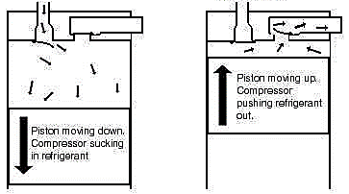
Cool low pressure refrigerant from the suction line enters the cylinder
Hot high pressure refrigerant exits the compressor into the condenser
Reed Valves
As the piston moves upward the refrigerant is compressed into the cylinder
As the piston moves down it pulls refrigerant into the cylinder

Slide 32
2018 REFRIGERATION TRAINING
Basic Refrigeration

Slide 33
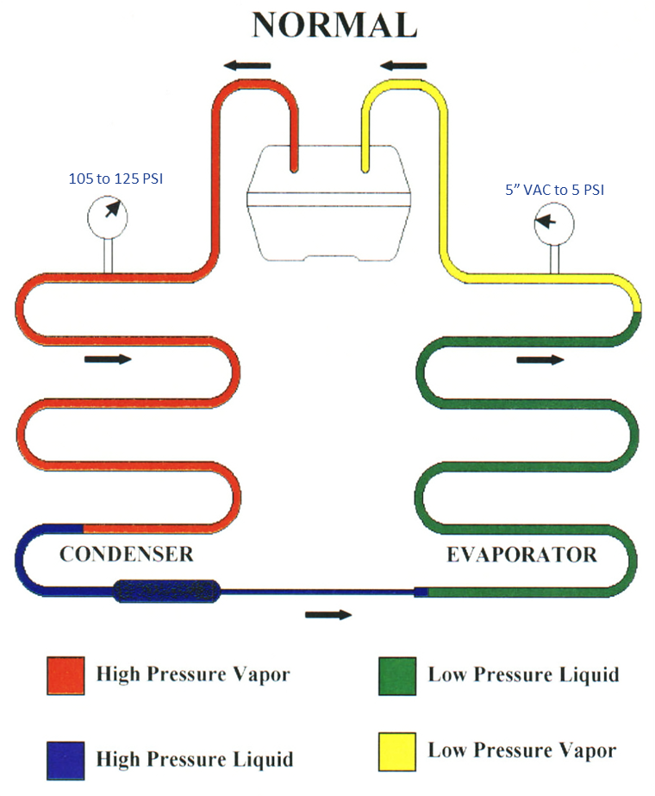
Sealed System Normal Operation
In a normal operating system, the compressor compresses the refrigerant into a hot high-pressure vapor (shown in red).
As the hot vapor passes through the condenser heat is given up to the ambient air.
When enough heat is removed the high-pressure vapor will condense into a high-pressure liquid (shown in blue).
This high pressure liquid leaves the condenser passes through the drier then enters the cap tube.

Slide 34
Sealed System Normal Operation
The liquid pressure drops as it passes through the cap tube and enters the evaporator as a low pressure liquid. (shown in green)
The low pressure will boils into a vapor because it absorbs heat as it passes through the evaporator resulting in a fully frost evaporator.
By the time the refrigerant reaches end of the evaporator the refrigerant is a low pressure vapor. (shown in yellow)
The low pressure vapor flows into the suction line to returned to the compressor to be pumped into a high pressure vapor again.

Slide 35
2018 REFRIGERATION TRAINING
Temperature Measurement

Slide 36
Temperature measurement
Temperature measurements in either the fresh food or freezer compartment should never be made of the air
Air temperature fluctuates drastically with door openings and depending upon whether the compressor is running, if it has just started running, or if it is near the end of the running cycle (show NewFI cycle history)
The most reliable method is to measure the temperature of food that has been in the center of the fresh food and freezer compartments for at least 24 hours
Always measure the temperature in both compartments placing the tip of the thermometer between two food packages
Wait at least four minutes before reading the thermometer as food temperatures may vary from morning to evening especially with heavy usage during the day

Slide 37
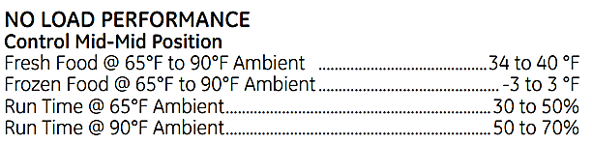
Temperature measurement
Measure the ambient (room) temperature
Compare the temperatures taken to the No Load Performance data in the Mini-Manual
No Load Performance is factory test data taken with no door openings, no defrosts, and no food load.
This closely simulates the condition in the home after approximately 8 hours of no usage (such as should normally exist first-thing-in-the-morning).
With usage the measured temperature will not equate the No Load Performance data
Unsatisfactory temperatures may be due to an improper installation or unusual consumer usage rather than an actual fault with the product

Slide 38
Temperature measurement
Accurate temperature measurements are extremely important in determining if a refrigerator or freezer is operating properly
Temperature measurements should be made on every call where the complaint is "poor performance“
Accurate temperature measurements are dependent upon the condition of the thermometer and the method used for making the measurements.
Various types of thermometers are available for measuring temperatures in refrigerators and freezers.

Slide 39
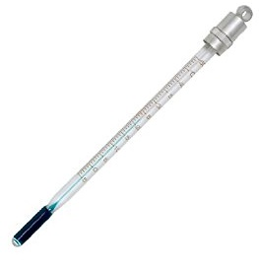
Temperature measurement
Liquid filled thermometers with a glass stem are generally very reliable but the glass is easily broken if the thermometer is dropped.

Slide 40
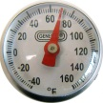
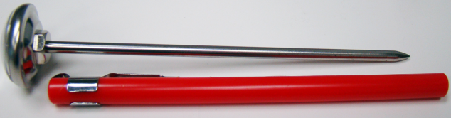
Temperature measurement
Dial (analog) type thermometers with a stainless steel stem are easy to use and are less prone to damage
To check the calibration place the tip of the thermometer into a cup of ice & water then stir for four minutes
The temperature of the ice water should be about 33°F
WX05X10412

Slide 41
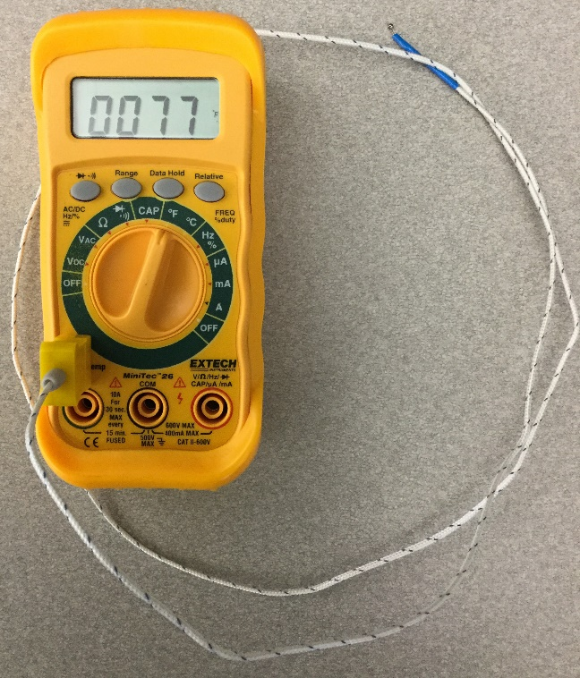
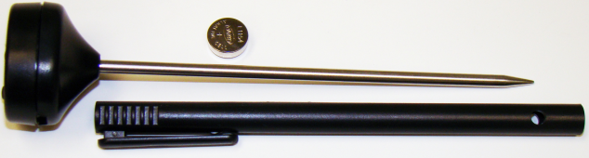
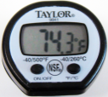
Temperature measurement
Digital Thermometers with a thermocouple give a quick (almost instantaneous) response and are easy to read.
Thermocouple and Battery must be in good condition for accurate readings
WX05X603
WX05X10413

Slide 42

Temperature measurement
Infrared Thermometers can be very useful when used in the right way and in the right applications. However you must understand their limitations:
Only measure surface temperatures and NOT the internal temperature of food or other materials
Require adjustments depending on the surface being measured emissivity
Emissivity describes how well an object emits infrared energy, or heat.
Are not thought to be as highly accurate as surface probes measurements of the same surface
Can be temporarily affected by frost, moisture, dust, fog, smoke or other particles in the air
Can be temporarily affected by rapid changes in ambient temperature
Can be temporarily affected by proximity to a radio frequency with an electromagnetic field strength of three volts per meter or greater
Do not "see through" glass, liquids or other transparent surfaces - even though visible light (like a laser) passes through them (i.e. if you point an IR gun at a window, you'll be measuring the temperature of the window pane, not the outside temp)

Slide 43
New slide

Slide 44
Temperature measurement

Slide 45
2018 REFRIGERATION TRAINING
Heat Energy

Slide 46
2018 REFRIGERATION TRAINING
Heat Energy

